Slide 1
BDA601 – BIG DATA AND ANALYTICS
Model evaluation
NHUT XUAN HUYNH NGO - A00115167

Slide 2

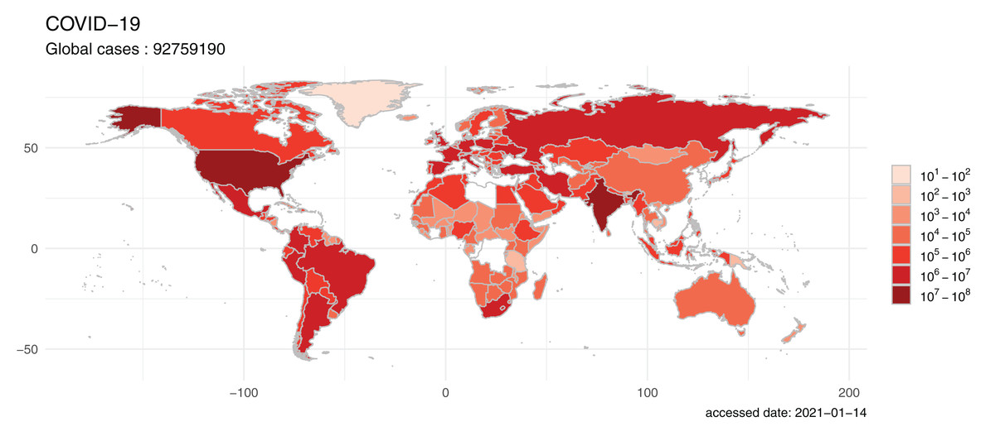
Agenda
Introduction
Data Analysis and visualization
Predictive Modelling
Clustering
Graph analytics
Conclusion

Slide 3
INTRODUCTION
The objective is mainly utilizing the methods of big data analytics to help the global community to face with COVID-19
Johns Hopkins University dataset has been selected for analyzing to uncover valuable insights.
The Methods will be used Predictive Modelling, Clustering, Graph Analytics and Visualizations to explore data and identify patterns with the use of programming approach.

Slide 4
Data Analysis and visualization
findings

Slide 5

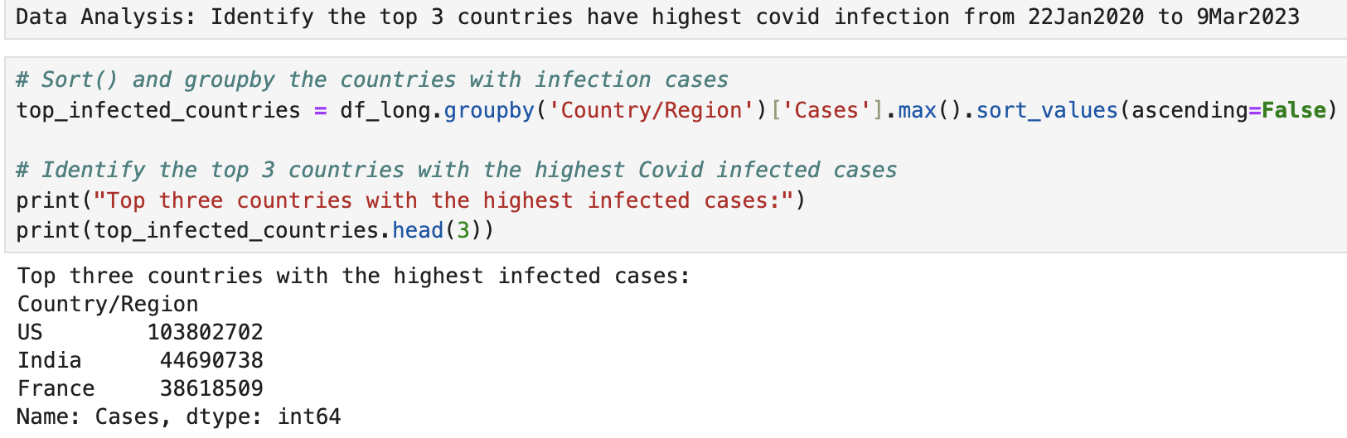
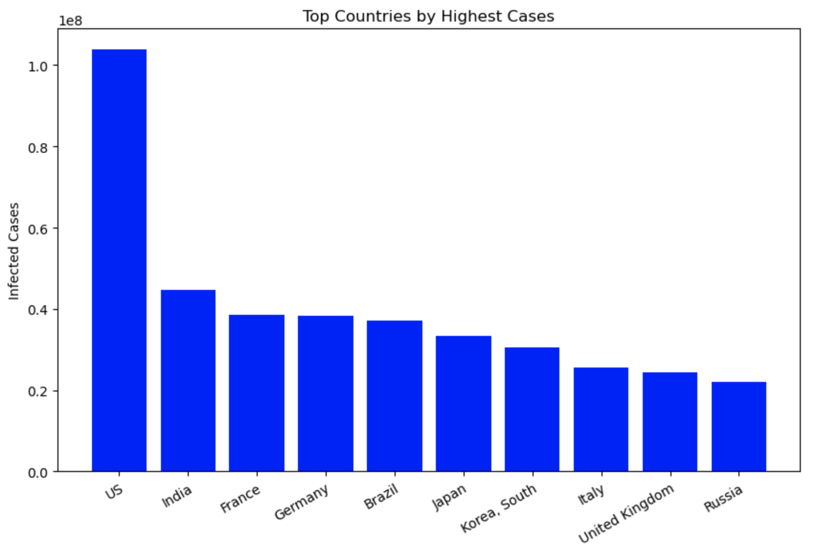
findings
Top 3 countries have highest number of Covid infections are US, INDIA AND FRANCE, respectively.
US has the highest variance in these three countries
3 Clusters were identified and named as following:
Low trend
Medium trend
High trend

Slide 6
PREDITIVE MODELLING
Data Analysis and visualization (cont.)
LINEAR REGRESSION MODEL to the time-series to represent and predict the covid infection rate trend over time base on the count of weekly infection by the week number for TOP 3 COUNTRIES
Identify the highest variance among top 3 countries.

Slide 7
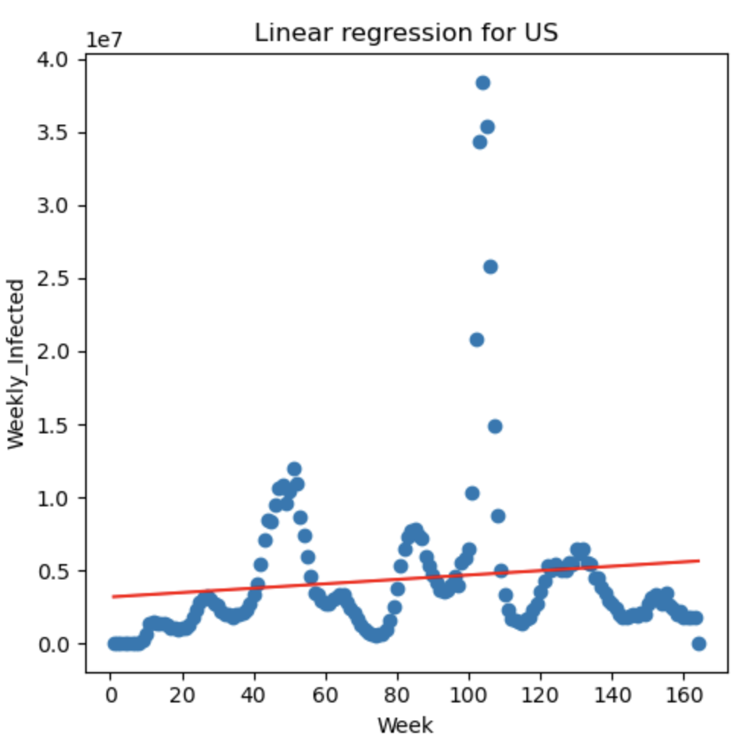
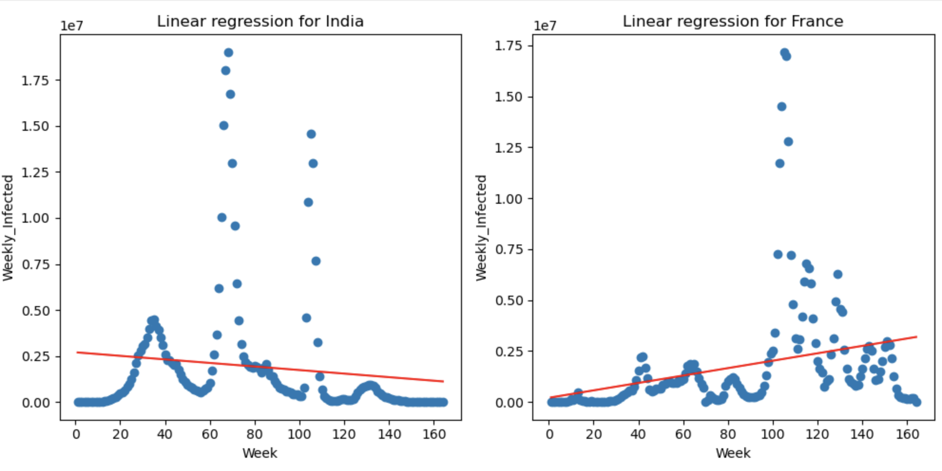
PREDITIVE MODELLING
Data Analysis and visualization (cont.)
US & France : positive correlation meaning the cases increase over time base on weekly infection rate
India: negative relation meaning the case have decrease over time base on weekly infection rate
Notes:
US & France: The regression line might have a positive slope, suggesting a correlation between the independent variable and the weekly infected count.
India: The line might show a negative relation, indicating a decrease in weekly infections when the overtime.

Slide 8
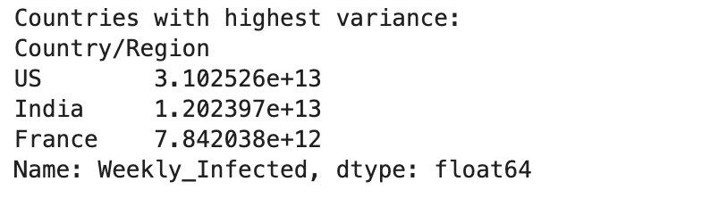
PREDITIVE MODELLING
Data Analysis and visualization (cont.)
US have the highest variance among top 3 infected countries meaning there are significant fluctuation every week.
Due to some factors:
Non-Uniform Public Health Measures
Vaccination Rates and Vaccine Hesitancy
Regional disparity
Notes:
Regional disparity: This can lead to significant regional variations in the spread of the virus. Areas with higher population density or less adherence to public health measures might see quicker spikes in cases, while rural areas might see lower caseloads.
Non-Uniform Public Health Measures: Public health responses to the pandemic have varied considerably across different US states. Some states implemented stricter lockdowns, mask mandates, and social distancing measures, while others were more relaxed. This inconsistency can contribute to differences in case trends across the country.
Vaccination Rates and Vaccine Hesitancy: Vaccination rates vary significantly across the US. Areas with lower vaccination coverage are more susceptible to outbreaks. Additionally, vaccine hesitancy in certain populations can further contribute to pockets of high infection rates.

Slide 9
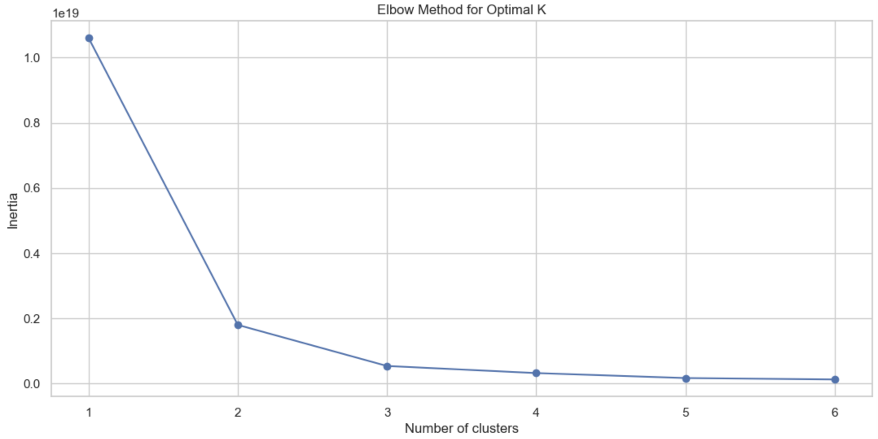
Clustering
Data Analysis and visualization (cont.)
Elbow method : a simple and often effective way to get a starting point for the number of clusters in K-means clustering.
K = 3 meaning 3 clusters is defined
Notes:
K-Means Clusterin is a data analysis technique commonly used to group data points into a specific number of clusters (K). In this scenario, it can be applied to group US locations based on the similarity of their weekly Covid-1cases. K=3

Slide 10
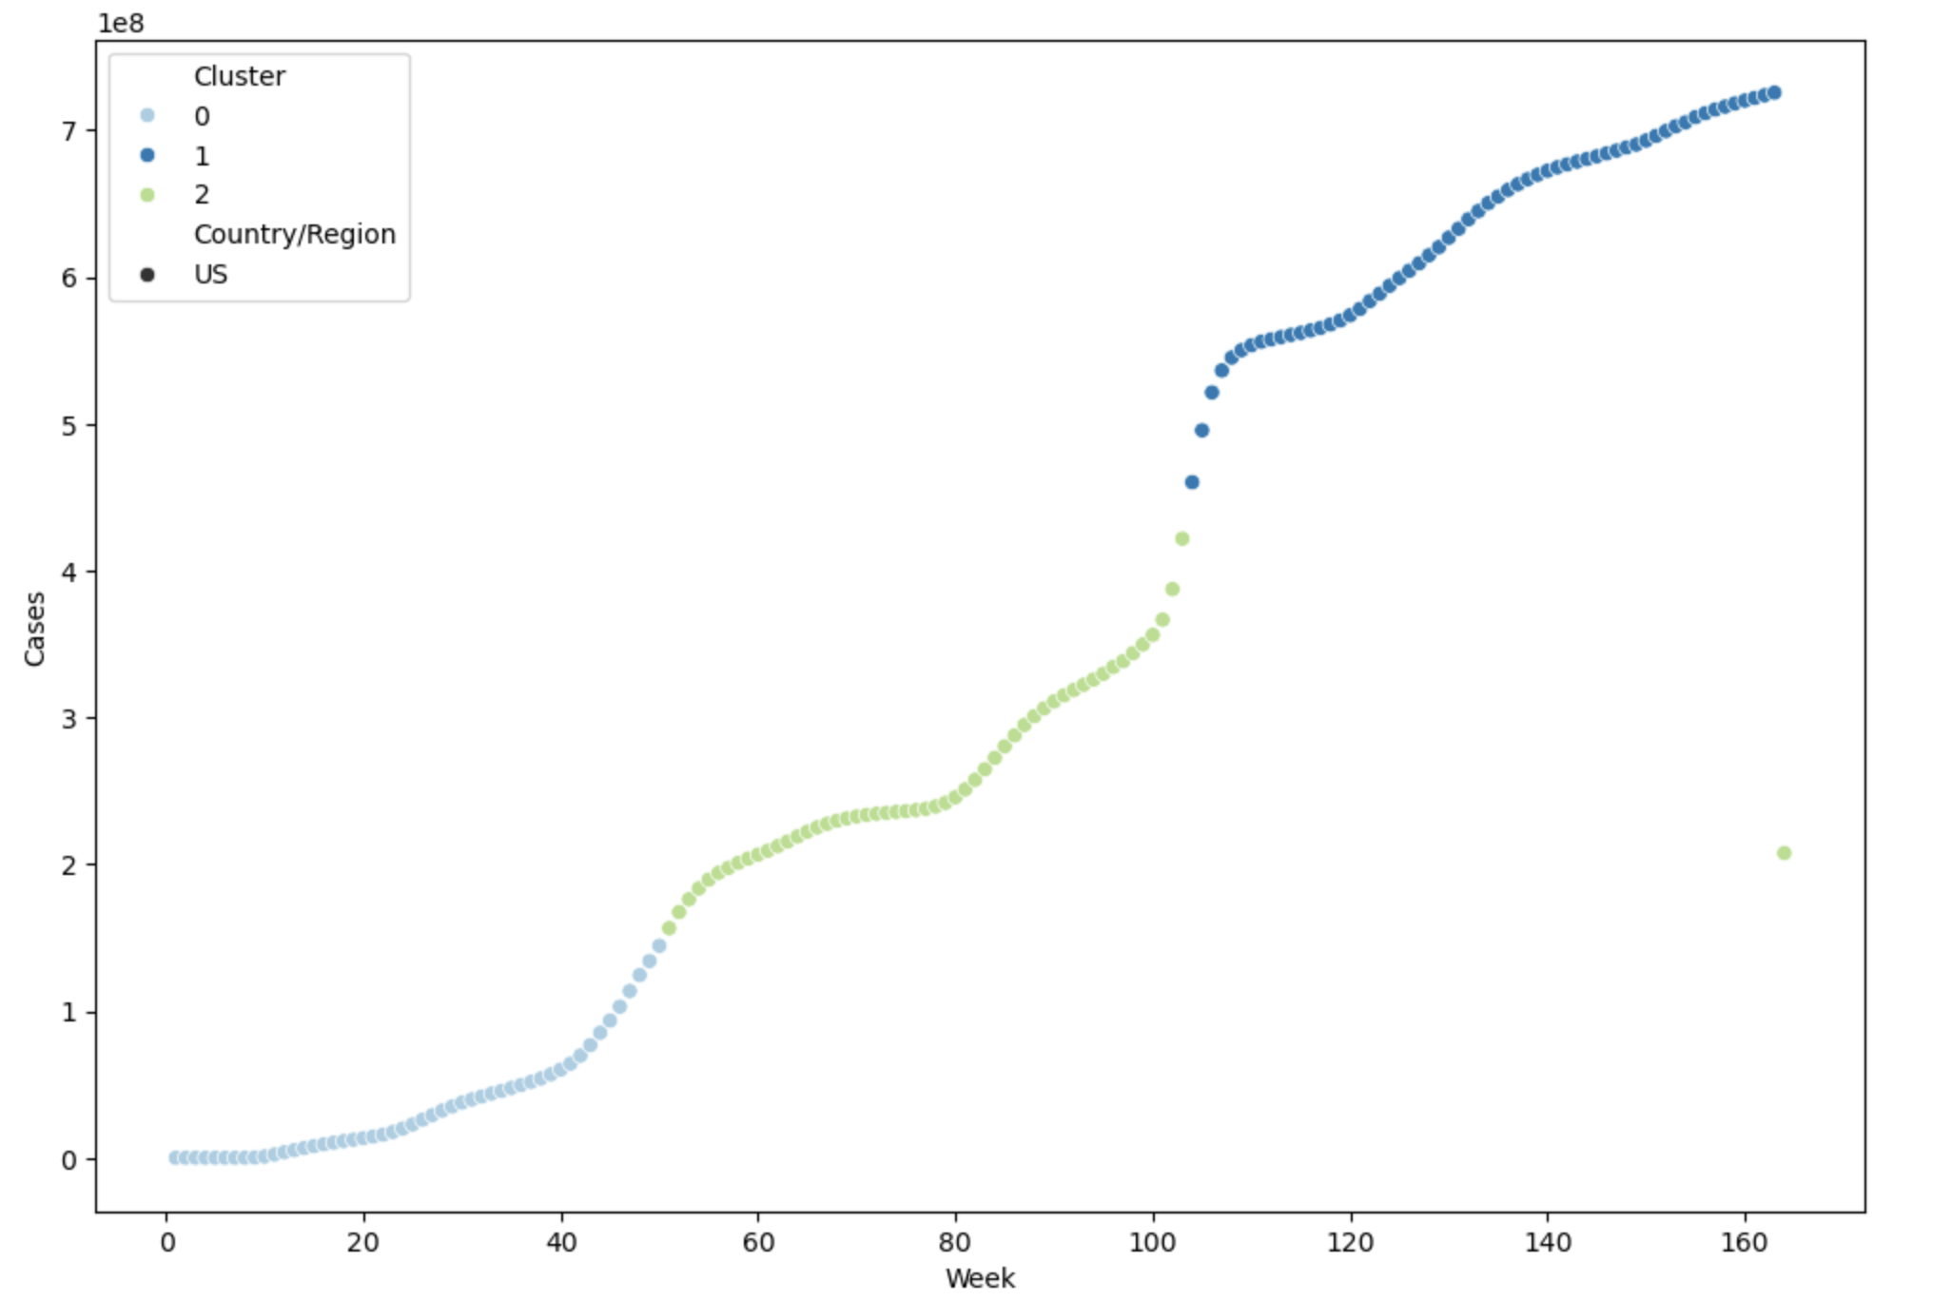
Clustering
Data Analysis and visualization (cont.)
Week 1-60:
Week 60-100:
Week 120-160:
Week 162-164:
Low trend
Medium trend
High trend
It show significant decrease from high trend to medium and nearly low trend
US need to more consistent with policies for covid and ensure its strict implementation
Notes:
Weeks 20-40: There's a gradual increase in cases week 40 in low trend
Weeks 40-80: There’s another increase in cases,
Week 162-164: It show significant decrease in week 162-164 from high trend to medium and nearly low trend

Slide 11
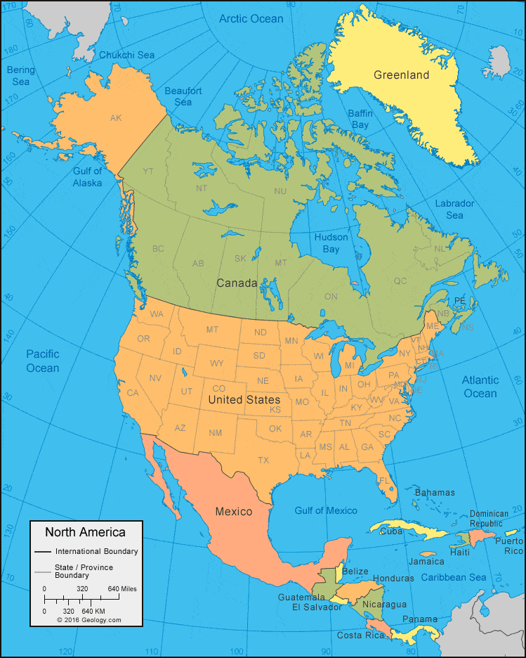
NEIGHBORING COUNTRIES
List countries neighbor of US
Canada
Mexico
Cuba
BAHAMAS
Dominican Republic
Haiti

Slide 12
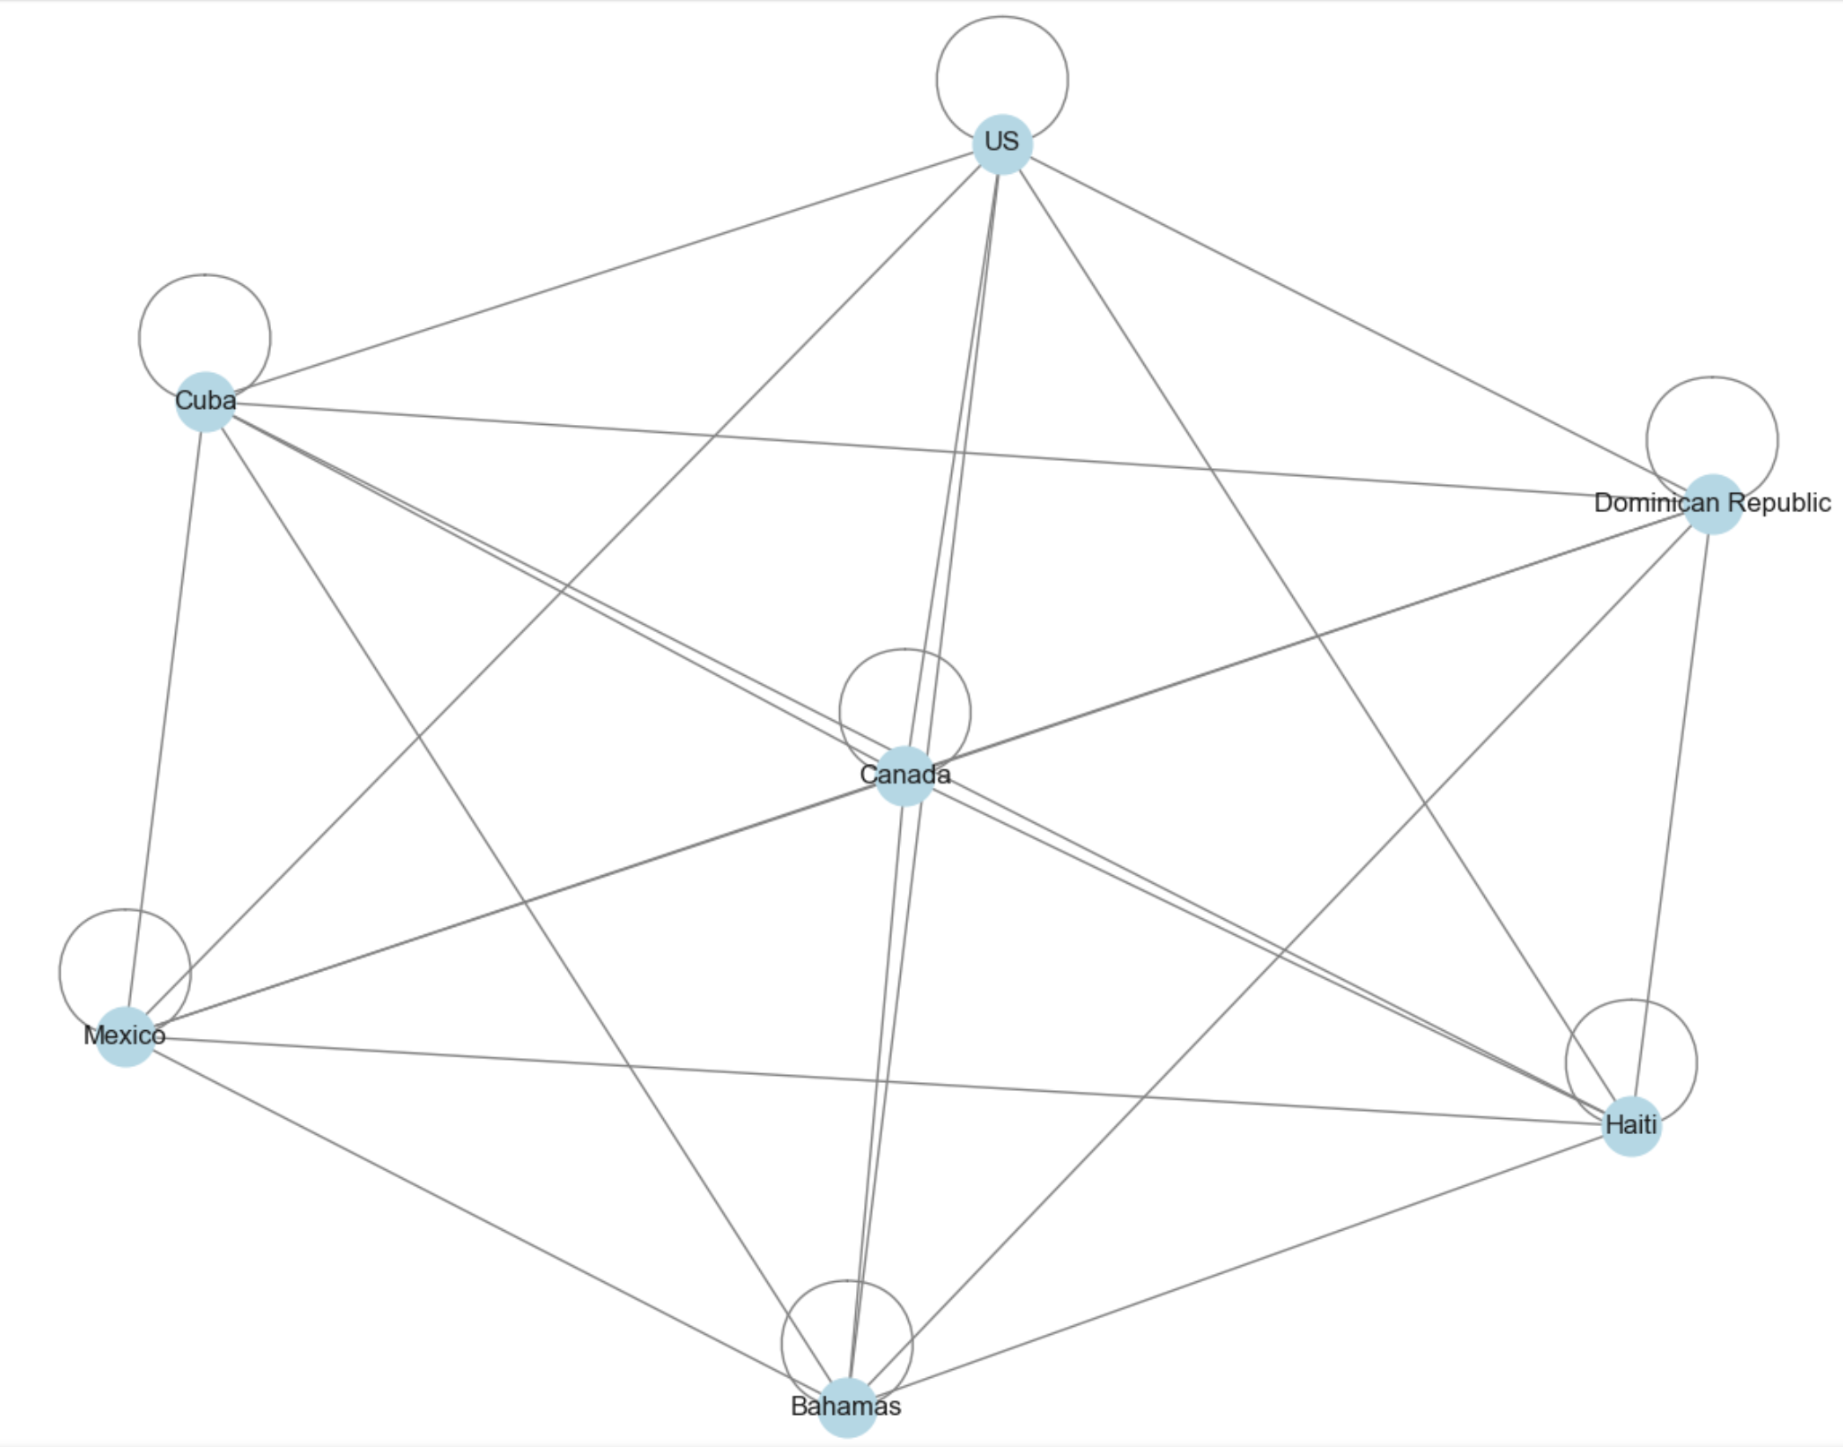
Graph analytic
Centrality Analysis Method
Relationship among Neighbor Countries based on similarity of covid infection rate within 5%

Slide 13
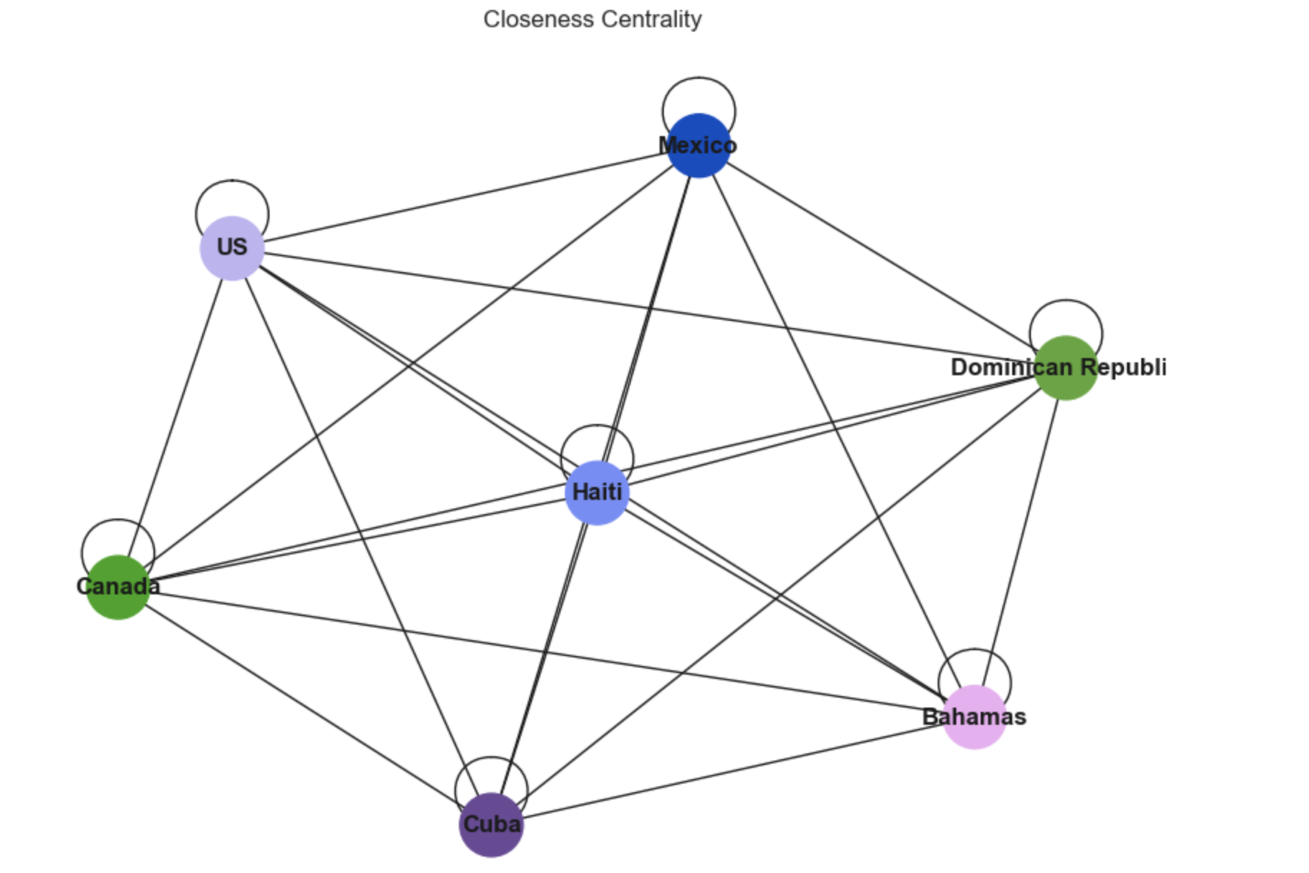
Graph analytic
Closeness Centrality: This metric calculates how close country is to all others in the network. The countries with high closeness centrality would be those that are "close" (in terms of infection similarity) to many other countries.

Slide 14
conclusion
US has the highest variance in these three countries (US, India, France) but still in high trend, however, it start to show decrease in infection rate weekly.
Some drawbacks:
Avoid-lock down
No Mask Mandate rules
Low Vaccination Rates
Strategy for US and its neighbor countries:
Strong Vaccination campaigns, Promote booster shots, Take covid more seriously, Support vulnerable community

Slide 15

Thank you

